Slide 1

Note: The data and information in this document is reflective of a hypothetical situation and client. This document is to be used for KPMG Virtual Internship purposes only.
Sprocket Central Pty Ltd
Data analytics approach
Aquib Hassan Shaikh

Slide 2
Note: The data and information in this document is reflective of a hypothetical situation and client. This document is to be used for KPMG Virtual Internship purposes only.
Agenda
Introduction
Data Exploration
Model Development
Interpretation

Slide 3
Note: The data and information in this document is reflective of a hypothetical situation and client. This document is to be used for KPMG Virtual Internship purposes only.
Introduction
Identify and Recommend Top 1000 Customer to Target from Dataset
Outline of Problem
Sprocket Central is a company that specializes in high quality bikes and cycling accessories
Their Marketing team is looking to boost the business sales by analysing provided datasets
Using 3 datasets provided the aim is to analyze and recommend 1000 customers that Sprocket Central should target to drive higher value for the company
Contents of Data Analysis
‘New’ and ‘Old’ Customer Age distributions
Bike related purchases over the last 3 years by gender
Job industry distributions
Wealth Segmentation by age category
Number of cars owned and not owned by state

Slide 4
Summary Table
Note: The data and information in this document is reflective of a hypothetical situation and client. This document is to be used for KPMG Virtual Internship purposes only.
Data Exploration
Data Quality Assessment and ‘Clean Up’
Key Issues for Data Quality Assessment
Accuracy : Correct Values
Completeness : Data Fields with values
Consistency: Values free from Contradiction
Currency: Values up to date
Relevancy : Data items with value Meta data Validity: Data Containing Allowable Values
Uniqueness : Records that are duplicated
Data Sheet | Accuracy | Completeness | Consistency | Currency | Relevancy | Validity
Customer Demographic | DOB : inaccurate Age : missing | Job title: blank Customer id: incomplete | Gender : inconsistency | Deceased customers: filter out | Default Column : delete
Customer Address |  | Customer id : incomplete | States: inconsistency
Transactions | Profit : missing | Customer id : Incomplete Online orders: blanks Brand: blanks |  |  | Cancelled Status order : filter out | List price: format Product sold date : format

Slide 5
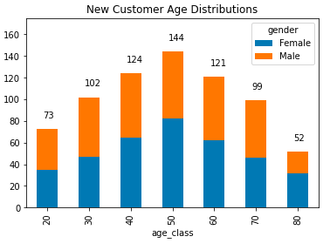
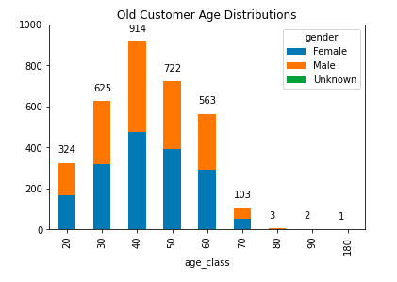
Note: The data and information in this document is reflective of a hypothetical situation and client. This document is to be used for KPMG Virtual Internship purposes only.
Data Exploration
‘New’ and ‘Old’ Customers age distribution
Most customers are aged between 40-50 in ‘New ’ and ‘Old’ customer list.
The lowest age groups are under 20 and 80+ for both ‘New ’ and ‘Old ’ customer list.
The ‘New’ customer list suggests that age groups 20-29 and 40-50 are most populated.
There is drop of customers in the 30-39 age group in ‘New’

Slide 6
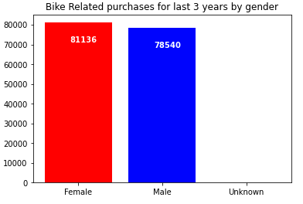
Note: The data and information in this document is reflective of a hypothetical situation and client. This document is to be used for KPMG Virtual Internship purposes only.
Data Exploration
Bike related purchases over last 3 years
Over the last three about 50% of bike related purchased were made by females to 48% purchases made by males. Few purchases were made by unknown gender.
Females make up majority of bike related sales

Slide 7
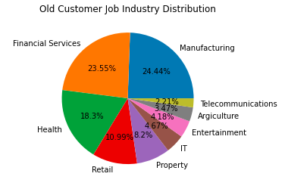
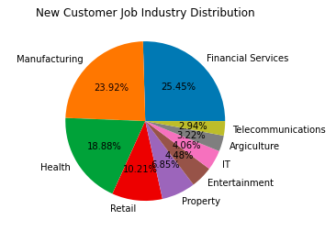
Note: The data and information in this document is reflective of a hypothetical situation and client. This document is to be used for KPMG Virtual Internship purposes only.
Data Exploration
Job Industry Distribution
20% of new customers are in Manufacturing and Financial Services
The smallest number of customers are in Agriculture and Telecommunications
Similar pattern in ‘Old ’ customer list, at 20% and 19% in Manufacturing and Financial Services resp.

Slide 8
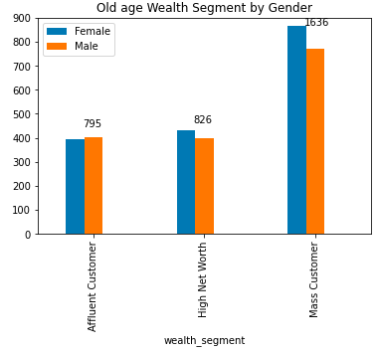
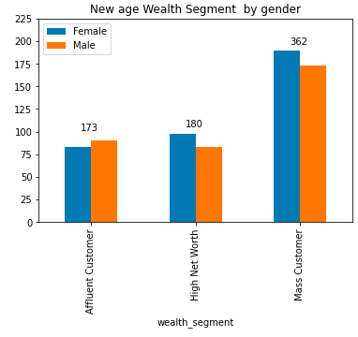
Note: The data and information in this document is reflective of a hypothetical situation and client. This document is to be used for KPMG Virtual Internship purposes only.
Data Exploration
Wealth Segmentation by Gender
In all age categories by gender the largest numbers of customers are classified as ’Mass Customer ’
The next category is the ‘ High New Worth’ customers.

Slide 9
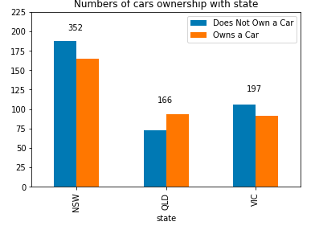
Note: The data and information in this document is reflective of a hypothetical situation and client. This document is to be used for KPMG Virtual Internship purposes only.
Data Exploration
Wealth Segmentation by Gender
NSW has the largest amount of people that do not own a car.
Victoria is also split quite evenly, But both numbers are significantly lower than those of NSW.
QLD has relatively highest number of customers own a car

Slide 10
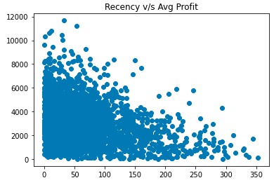
Note: The data and information in this document is reflective of a hypothetical situation and client. This document is to be used for KPMG Virtual Internship purposes only.
Data Exploration
Scatter Plot based off RFM Analysis
The chart shows that customer who purchased more recently have generated more revenue, than customer who visited a while ago.
Customers from recent past (50-100) days also show to generate a moderate amount of revenue.
Those who visited more than 200 days ago generated low revenue.

Slide 11
Note: The data and information in this document is reflective of a hypothetical situation and client. This document is to be used for KPMG Virtual Internship purposes only.
Model Development
Customer title definition list with RFM values assigned
Rank | Customer Title | Description | RFM value
1 | Platinum Customer | Most recent buy, buys often, most spent | 444
2 | Very Loyal | Most recent, buy often, spends larger amount of money | 433
3 | Becoming Loyal | Relatively recent, bought more than once , spends large amount of money | 421
4 | Recent Customer | Bought recently, not very often, average amount spent | 344
5 | Potential Customer | Bought recently, never bought before, spent small amount | 323
6 | Late Bloomer | No recent purchase, but RFM value is larger than average | 311
7 | High Risk Customer | Purchase for long time ago, frequency was quite high, amount spent is high | 224
8 | Almost Lost Customer | Very low recency, low frequency, but high amount spent | 212
9 | Lost Customers | Very low RFM | 111
.

Slide 12
Note: The data and information in this document is reflective of a hypothetical situation and client. This document is to be used for KPMG Virtual Internship purposes only.
Interpretation
Summary Table of the top 1000 customers to Target
Rank | Customer Title | Description | No. of Customers | Cumulative | Customer Selection
1 | Platinum Customer | Most recent buy, buys often, most spent | 176 | 176 | 176
2 | Very Loyal | Most recent, buy often, spends larger amount of money | 184 | 360 | 184
3 | Becoming Loyal | Relatively recent, bought more than once , spends large amount of money | 344 | 704 | 344
4 | Recent Customer | Bought recently, not very often, average amount spent | 368 | 1072 | 269
5 | Potential Customer | Bought recently, never bought before, spent small amount | 355 | 1427 | 0
6 | Late Bloomer | No recent purchase, but RFM value is larger than average | 333 | 2116 | 0
7 | High Risk Customer | Purchase for long time ago, frequency was quite high, amount spent is high | 360 | 2476 | 0
8 | Almost Lost Customer | Very low recency, low frequency, but high amount spent | 326 | 2802 | 0
9 | Lost Customers | Very low RFM | 290 | 3493 | 0
.

Slide 13
Filter through top 1000 customers by assigning the conditions discussed in the table above. The 1000 customers discovered would have bought recently, they have bought very frequently in the past and tend to spend more than other customers.
Note: The data and information in this document is reflective of a hypothetical situation and client. This document is to be used for KPMG Virtual Internship purposes only.
Interpretation
Customer Target and Methodology
Rank | Customer Title | Description | No. of Customers | Cumulative | Customer Selection
1 | Platinum Customer | Most recent buy, buys often, most spent | 176 | 176 | 176
2 | Very Loyal | Most recent, buy often, spends larger amount of money | 184 | 360 | 184
3 | Becoming Loyal | Relatively recent, bought more than once , spends large amount of money | 344 | 704 | 344
4 | Recent Customer | Bought recently, not very often, average amount spent | 368 | 1072 | 269
.

Slide 14
Note: The data and information in this document is reflective of a hypothetical situation and client. This document is to be used for KPMG Virtual Internship purposes only.
Appendix

